Slide 1
4D CELL Biology Lab - Projects

Slide 2
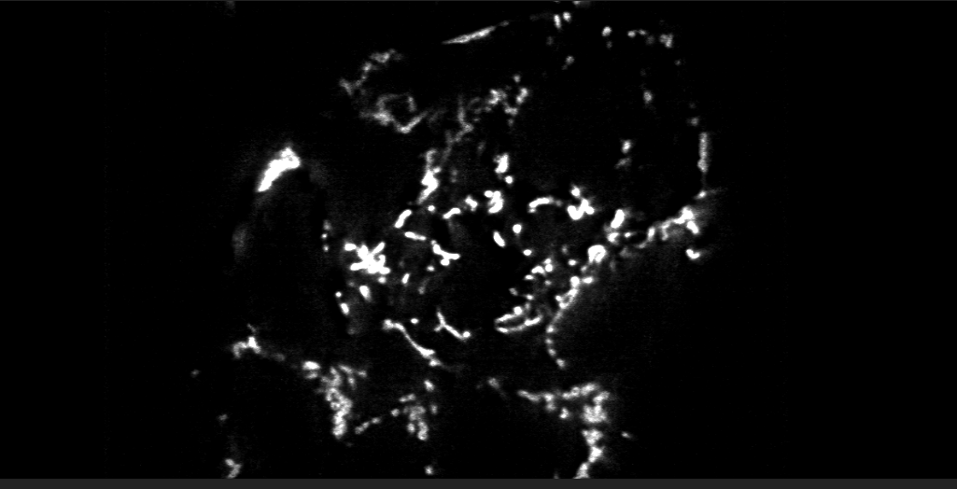
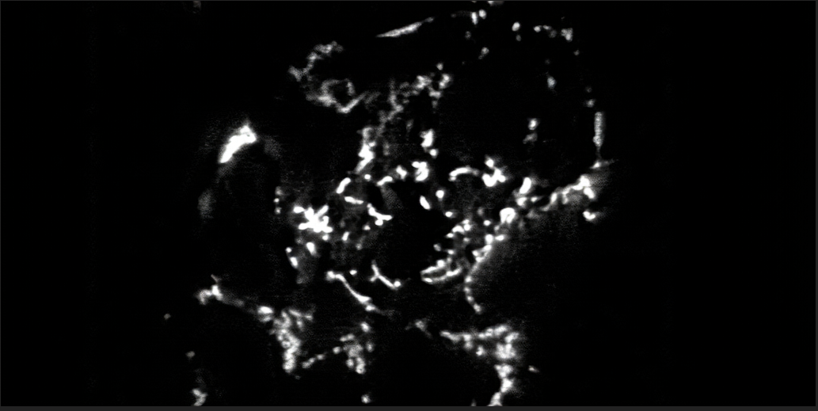
Project 1 - LPIPS
Task is to find how similar given 2 images are
Image 1
Image 2

Slide 3
Project 1 - Methodology
LPIPS similarity [Zhang et. al] is used to measure how similar 2 the given images are
Random patches were selected from the image and perceptual similarity code was run on these randomly selected patches which gave distance as a metric.
Smaller the returned number, more similar the images are
Distance metric for the whole image was found to be 0.035 indicating that the image as a whole is quite similar.
5 random patches of size 100x100 are selected from the given images are selected and similarity measure was applied

Slide 4
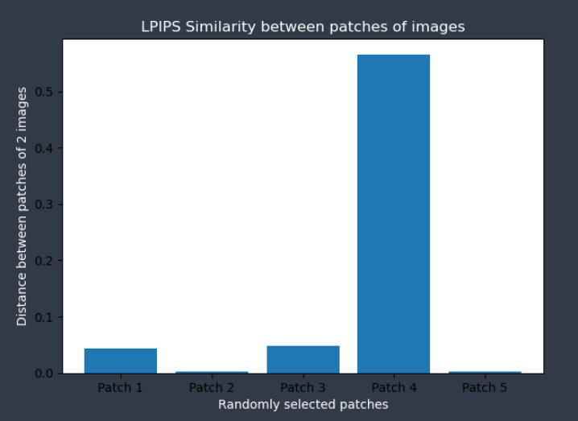
Project 1 - Methodology
Resulting distance measures for 5 patches were plotted against patch number as shown below.

Slide 5
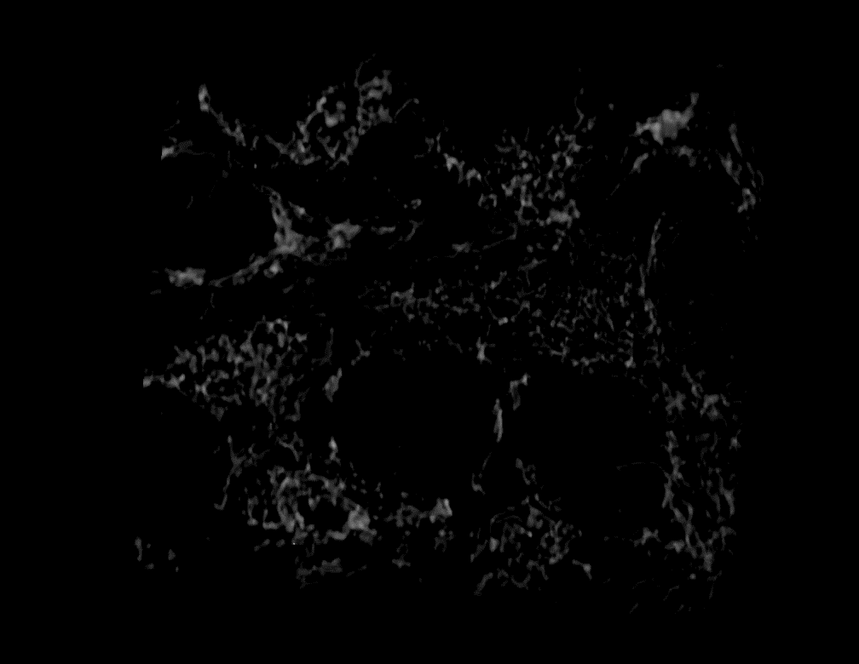
Project 2 – Image Segmentation using Deep Learning
Task is to build a deep learning model to perform semantic segmentation of the given image
Image format – TIF
Image size – 57 x 445 x 445

Slide 6
Project 2 – Approach
Different available models to perform 3D segmentation
3D U-Net
VGG Net
Modified Alex Net
Inception Net
Due to lack of training data 3D U-Net architecture was chosen
Training details :
Batch size – 16
Epochs – 50
Optimizer – Adam optimizer
Loss – Binary cross entropy

Slide 7
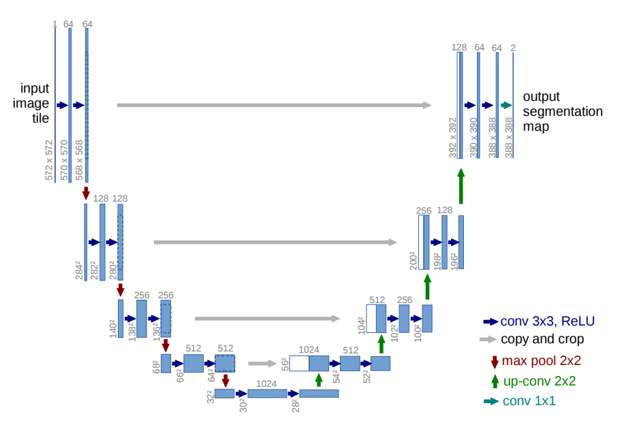
Project 2 – U-Net Architecture
Intended for Biomedical image segmentation due to lack of vast training data
Relies on data augmentation to work with available samples
Fig 1. U-net architecture - U-Net: Convolutional Networks for Biomedical Image Segmentation 2015, Ronneberger, Fischer and Brox

Slide 8
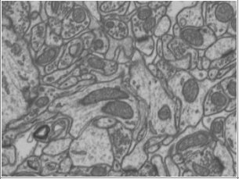
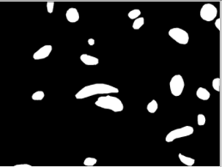
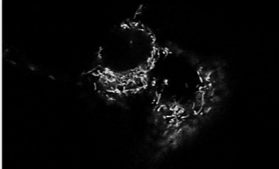
Project 2 – Approach
Initial training was performed on electron microscopy data set
Not entirely suitable for the task at hand as the segmented “filaments” must be finer
Obtained images from https://figshare.com/articles/figure/Mitochondrial_Event_Localiser/11830458/1 which are closer to the test image

Slide 9
Project 2 – Approach
Size of training data: 6 x 512 x512
Number of images: 6
6 TIF images were split to form 36 512 x 512 images
Each of these images were then split into patches of sizes 256x256, 128x128, 64x64 in three different instances to verify which patch size would result in finer segmentation
Accuracy of the model on different patch sizes was ~99% for all patch sizes
Intersection of Union (IoU), a better metric for image segmentation, however changed drastically for different sizes
64 x 64 patch size results in better segmentation at the cost of computation time
Patch Size | IoU
256 x 256 | 56.52%
128 x 128 | 74.89%
64 x 64 | 77.40%

Slide 10
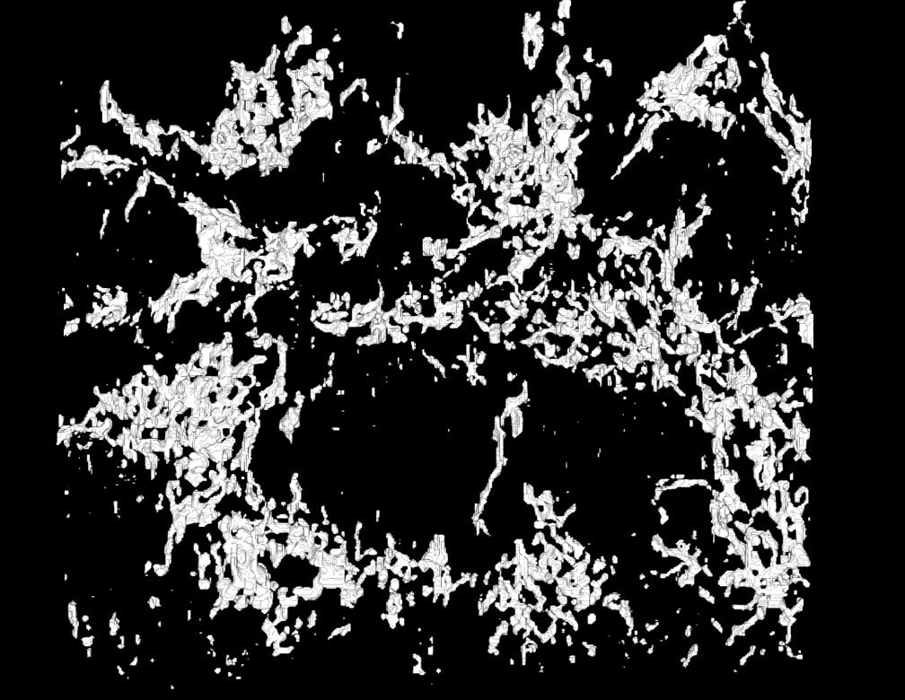
Project 2 – Result
Trained model was used to predict segmented TIF mask for the given image
Given image was resized from 445x445 to 512x512 for creating patches
Segmented images for individual patches are predicted and stitched to form 512x512 image output which was then resized back to 445x445

Slide 11
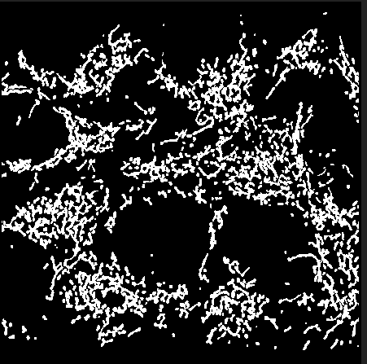
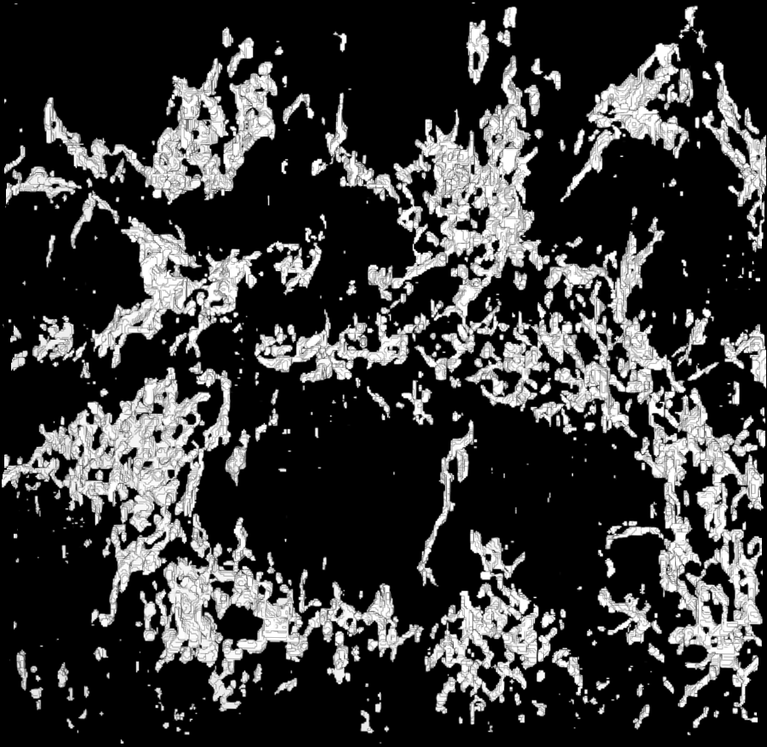
Project 2 – Result - Comparison
Expected TIF Mask
Segmented TIF Mask

Slide 12
Project 2 – Future work
Encoder part of the U-Net can be replaced with other well-known networks such as VGG net, Inception net etc.,
LPIPS similarity measure can be applied to expected image and the output image for verification
Manual dataset creation using online tools such as apeer can be performed for better accuracy of the segmented image

Slide 13
References
Dataset: https://figshare.com/articles/figure/Mitochondrial_Event_Localiser/11830458/1
U-Net: https://arxiv.org/abs/1505.04597
Image Segmentation using Deep Learning: A Survey: https://arxiv.org/abs/2001.05566
The Unreasonable Effectiveness of Deep Features as a Perceptual Metric: https://richzhang.github.io/PerceptualSimilarity/
A Brief Survey on Semantic Segmentation with Deep Learning: https://www.sciencedirect.com/science/article/abs/pii/S0925231220305476
Digital Sreeni: https://www.youtube.com/channel/UC34rW-HtPJulxr5wp2Xa04w

